Slide 1
E-Learning Platform
CSE327.6
Faculty: Sarnali Basak(SLB)
Md Nafiz Al Mahmud
ID:2012241042
Mia Mahmudul Houque Shaon
ID: 2014314042
Asif Rahman
ID: 2012691042
Md Nazmul Islam Srabon
ID: 2021227042

Slide 2
Problem Statement
Students not being able to study online with verified teachers, through a simple but effective platform.
Our Proposed Solution
A simple E-Learning Web Application

Slide 3
Vision Statement
For: Student and teachers
Who: want a simple but effective education platform
The: Jibon-Juddho is an online web application
That: provides the ability for a student to study much more comfortably. As well as for the teachers to share their study materials with the students through a simple, intuitive interface.
Unlike: currently available systems our application is free.
Our: application will provide a simple but effective interface and will also make sure that the teachers are verified.
Jibon-Juddho is an online web application for students and teachers who want a simple but effective education platform. Unlike currently available platforms, Jibon-Juddho is a free platform . It will provide a simple, intuitive interface that will also make sure that the teachers are verified and make study much more comfortable.
.
Vision Statement

Slide 4

Student
Registration and login
Enrol and Drop
Edit profile
Delete account
Contents Title
Admin
Login
Add and Remove other types of users
Manage the whole system
Teacher
Registration and login
Upload course material
Edit Profile
Delete account

Slide 5
Functional Requirements
Students must register to enrol.
The system must allow the students to see the teacher’s profile.
Teachers must complete the verification process to register
Teachers should be able to publish their course materials
The student must be able to search for courses.
The system must allow the admin to add or remove students and
teachers account.

Slide 6
Non-functional Requirements
The users can request to remember their passwords.
Students can evaluate their respective course instructors.
Forgetful users can reset their password.
The system will provide technical support if requested.
The admin can look for teachers to offer new course.

Slide 7
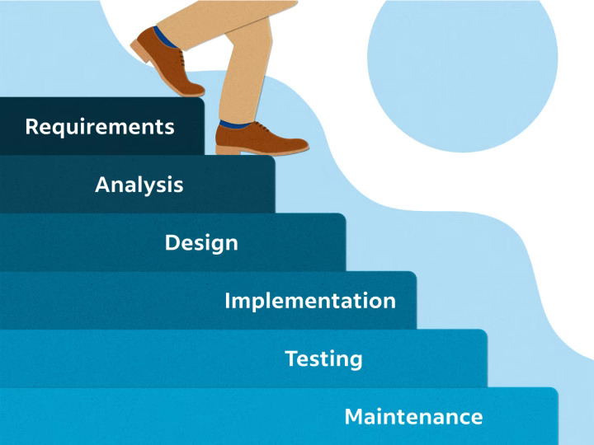
SDLC Model
The model we are using for our project is Waterfall Model.
Why?
 | 1
 | The requirements are precisely documented.
 | 2
 | The Project is short.
 | 3
 | Simple and easy to understand

Slide 8
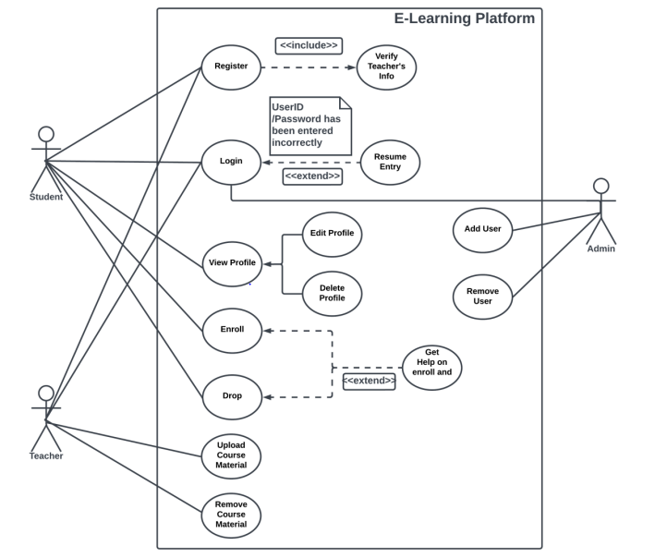
Use case Diagram

Slide 9
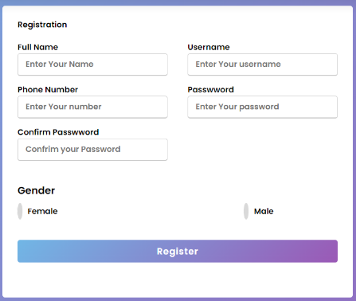
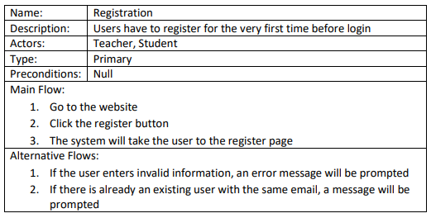
Use Cases

Slide 10
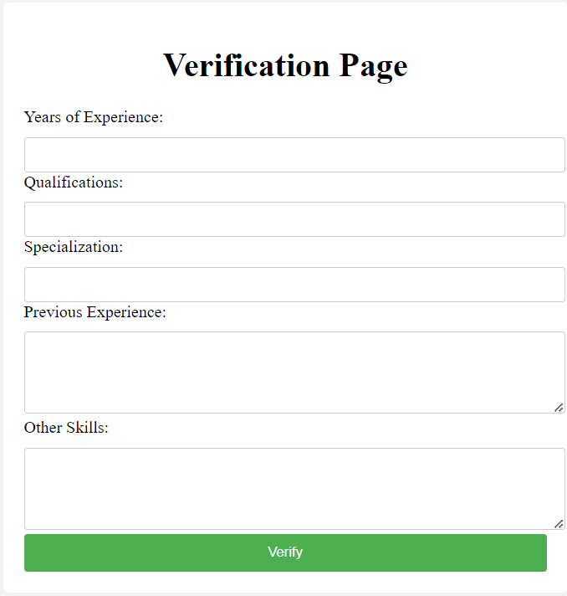
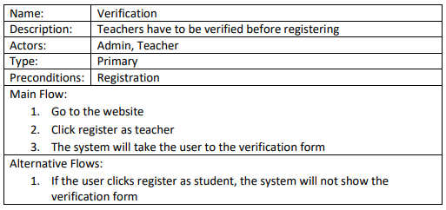
Use Cases

Slide 11
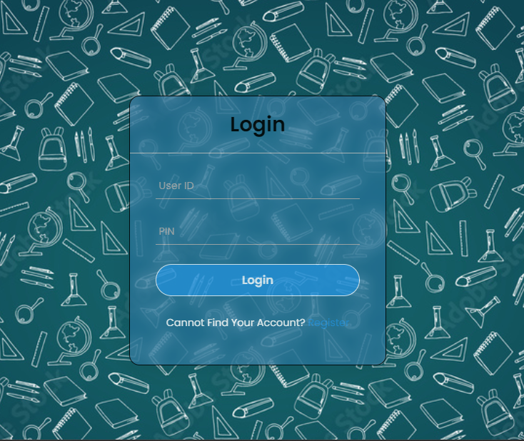
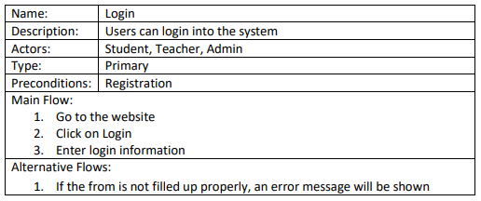
Use Cases

Slide 12
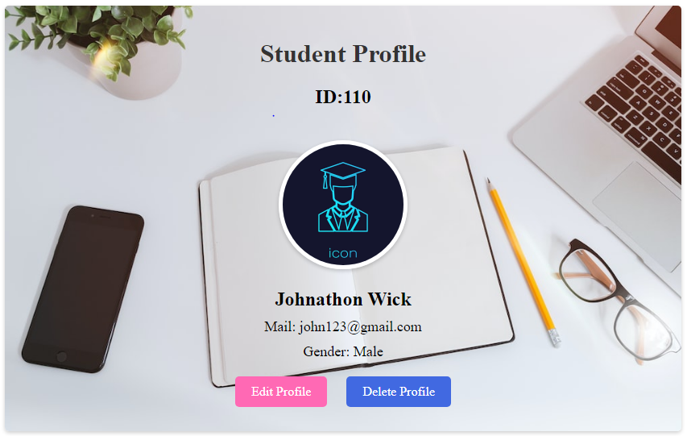
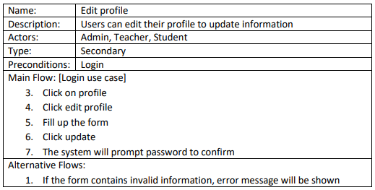
Use Cases

Slide 13
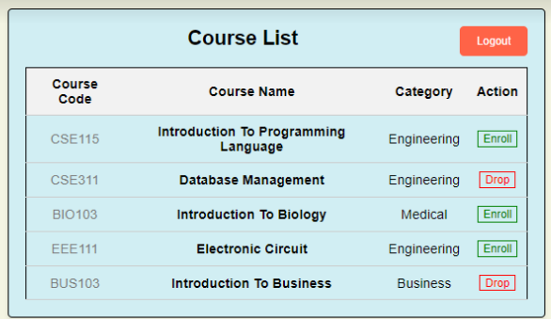
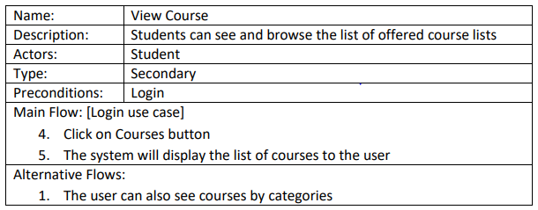
Use Cases

Slide 14
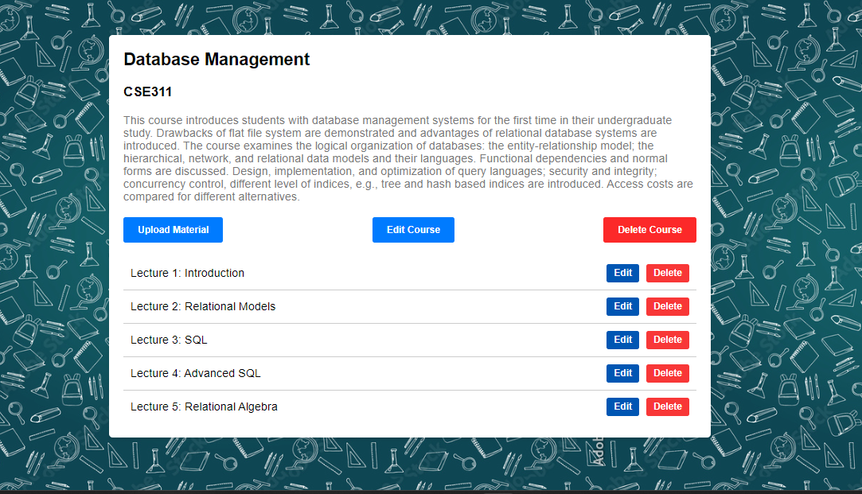
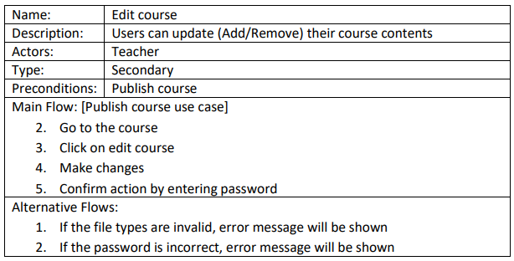
Use Cases

Slide 15
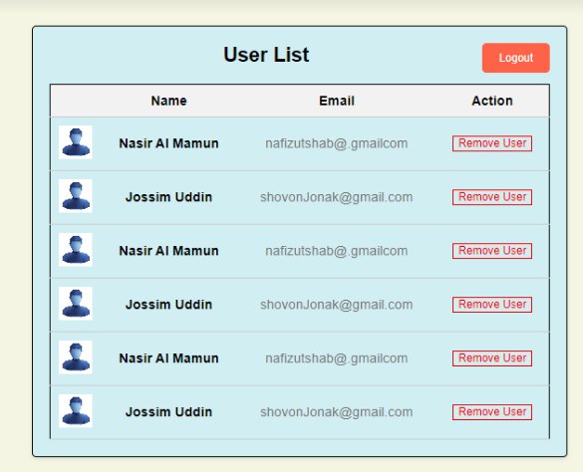
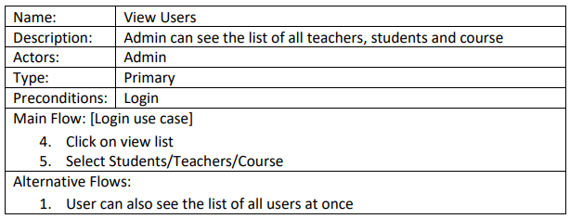
Use Cases

Slide 16
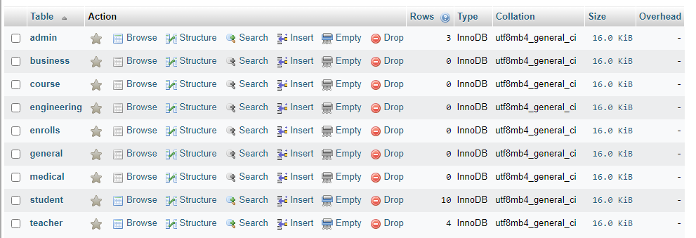
Database

Slide 17
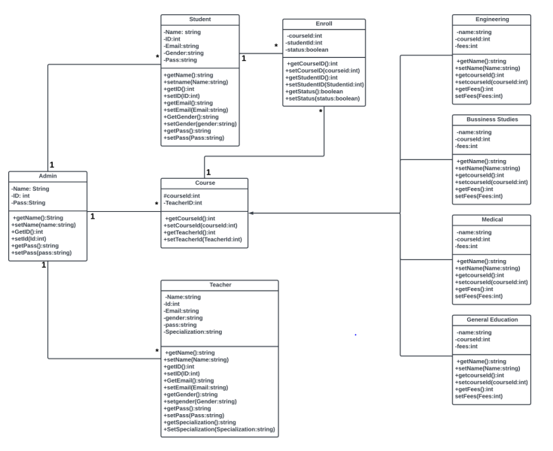
Class Diagram

Slide 18
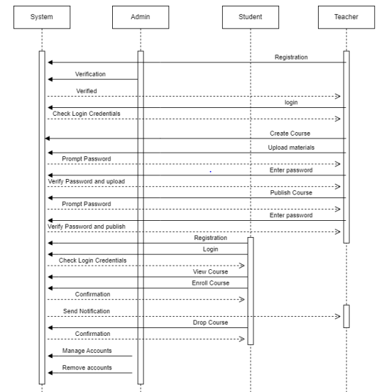
Sequential Diagram

Slide 19
Thank You!

